Slide 1




prioritizr Systematic conservation planning in R R
Richard Schuster & Jeffrey Hanson
jeffrey.hanson@uqconnect.edu.au
prioritizr.net

Slide 2
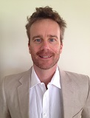
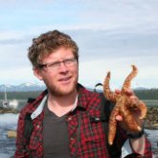
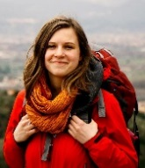
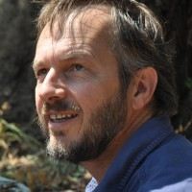
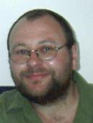
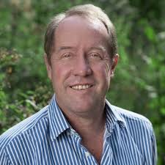
Acknowledgements
Matt Strimas-Mackey
Nina Morrell
Matt Watts
Joe Bennett
Peter Arcese
Hugh Possingham

Slide 3

prioritizr
Design your problem
Find optimal solutions
Ideally, fast!

Slide 4
Why ?
It’s free
Reproducibility
Flexible interface
Diverse package ecosystem
So many resources: Stackoverflow, tutorials, blogs, twitter, slack channels, mailing lists

Slide 5
Human-readable code
Mental model
problem <- data +
objective +
constraints +
penalties +
decision type +
solver
solution <- solve(problem)

Slide 6
Human-readable code
Mental model
Code
problem <- data +
objective +
constraints +
penalties +
decision type +
solver
solution <- solve(problem)
p <- problem(areas, feats) %>%
add_min_set_objective() %>%
add_relative_targets(0.1) %>%
add_boundary_penalties(5) %>%
add_binary_decisions() %>%
add_rsymphony_solver()
solution <- solve(p)

Slide 7
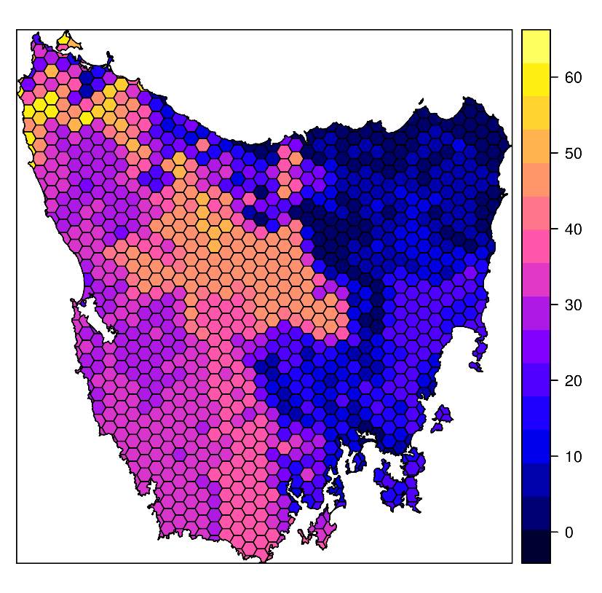
Design your problem
Study area: Tasmania, Australia
Planning units: 1130 hexagons
Features: 63 vegetation types

Slide 8
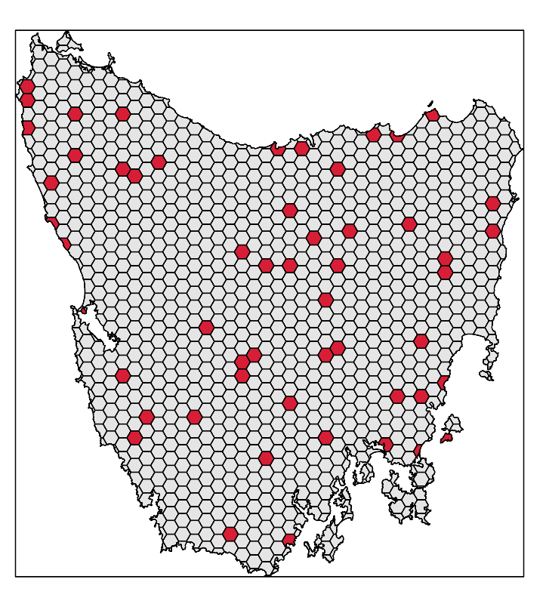
Design your problem
problem(tas_pu, tas_features,
"cost") %>%
add_min_set_objective() %>%
add_relative_targets(0.1) %>% add_binary_decisions() %>%
add_gurobi_solver(gap = 0) %>% solve()

Slide 9
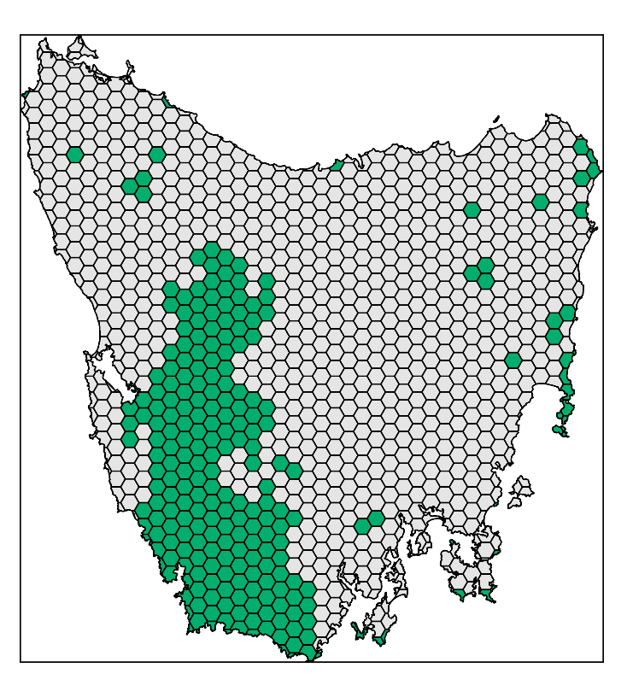
Design your problem
problem(tas_pu, tas_features,
"cost") %>%
add_min_set_objective() %>%
add_relative_targets(0.1) %>% add_locked_in_constraints("in") %>%
add_binary_decisions() %>%
add_gurobi_solver(gap = 0) %>% solve()

Slide 10
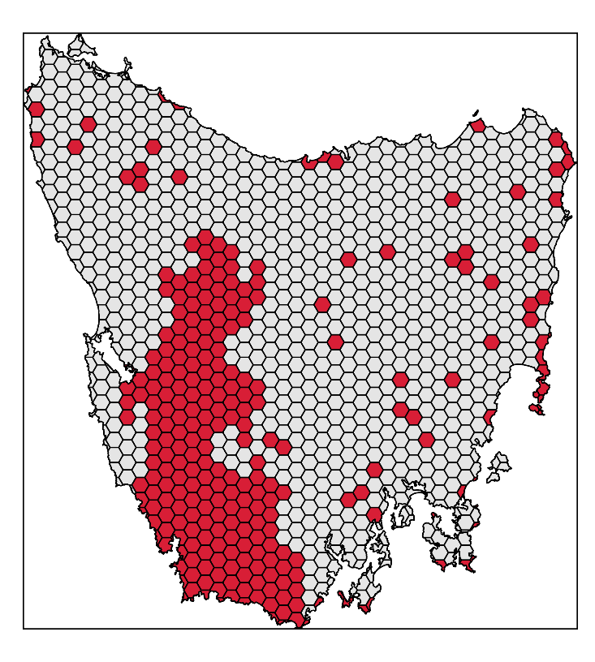
Design your problem
problem(tas_pu, tas_features,
"cost") %>%
add_min_set_objective() %>%
add_relative_targets(0.1) %>% add_locked_in_constraints("in") %>%
add_binary_decisions() %>%
add_gurobi_solver(gap = 0) %>% solve()

Slide 11
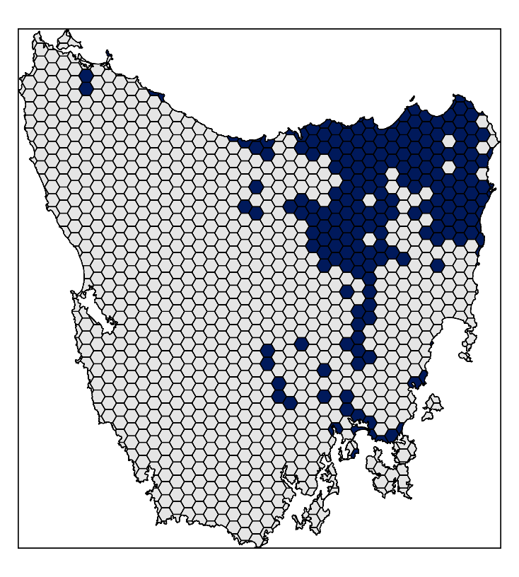
Design your problem
problem(tas_pu, tas_features,
"cost") %>%
add_min_set_objective() %>%
add_relative_targets(0.1) %>% add_locked_in_constraints("in") %>%
add_locked_out_constraints("out") %>%
add_binary_decisions() %>%
add_gurobi_solver(gap = 0) %>% solve()

Slide 12
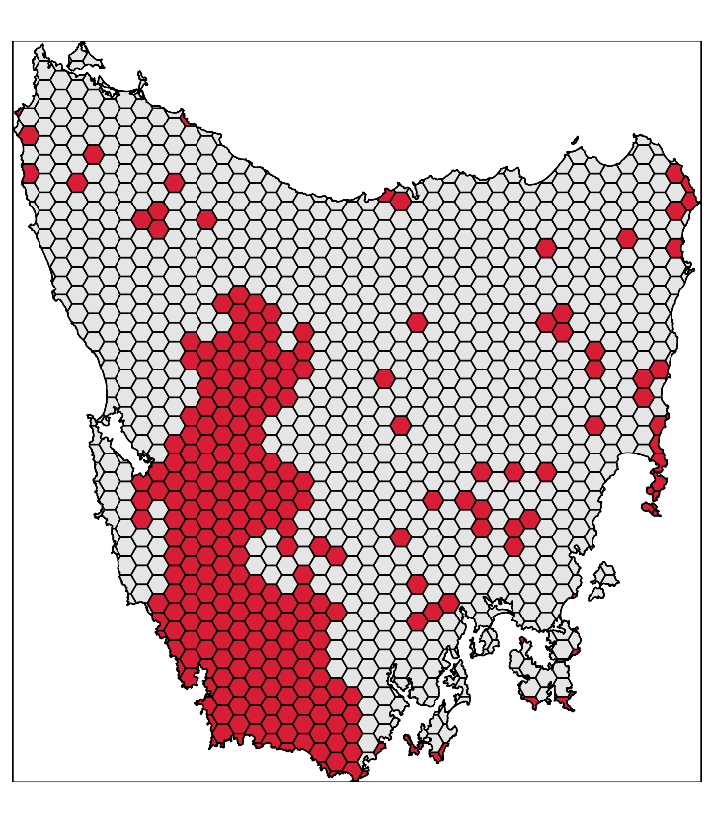
Design your problem
problem(tas_pu, tas_features,
"cost") %>%
add_min_set_objective() %>%
add_relative_targets(0.1) %>% add_locked_in_constraints("in") %>%
add_locked_out_constraints("out") %>%
add_binary_decisions() %>%
add_gurobi_solver(gap = 0) %>% solve()

Slide 13
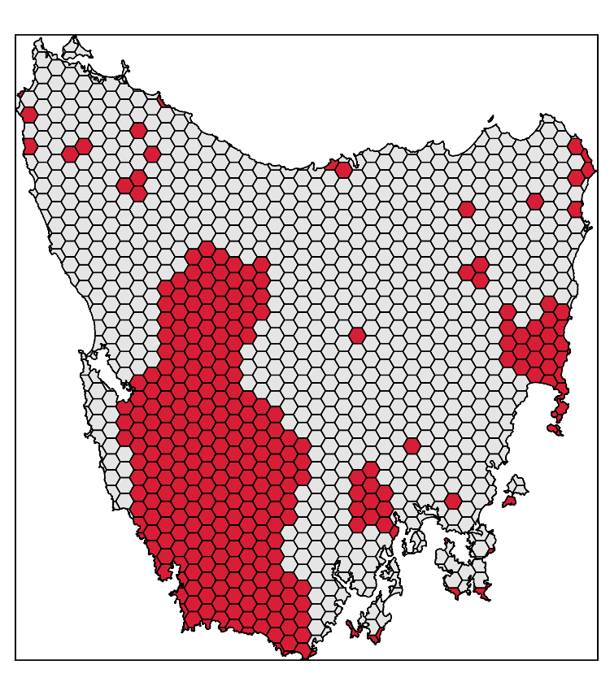
Design your problem
problem(tas_pu, tas_features,
"cost") %>%
add_min_set_objective() %>%
add_relative_targets(0.1) %>% add_locked_in_constraints("in") %>%
add_locked_out_constraints("out") %>%
add_boundary_penalties(0.01, 0.5) %>%
add_binary_decisions() %>%
add_gurobi_solver(gap = 0) %>% solve()

Slide 14
Design your problem
Objectives
add_max_features_objective
add_max_phylo_objective
add_max_utility_objective
add_min_set_objective
Penalties
add_connectivity_penalties
add_boundary_penalties
add_feature_weights
Decisions
add_bindary_decisions
add_proportion_decisions
add_semicontinuous_decisions
Constraints
add_feature_contiguity_constraints
add_contiguity_constraints
add_locked_in_constraints
add_locked_out_constraints
add_neighbour_constraints
Solvers
add_gurobi_solver
add_lpysmphony_solver
add_rsymphony_solver

Slide 15
Design your problem
problem(pu, fts, "cost") %>%
add_min_set_objective() %>%
add_relative_targets(…) %>% add_binary_decisions() %>%
solve()
Single zone
problem
problem(pu, zones(fts_z1, fts_z2, …),
c("cost_1", "cost_2", …)) %>%
add_min_set_objective() %>%
add_relative_targets(…) %>% add_binary_decisions() %>%
solve()
Multi-zone
problem

Slide 16
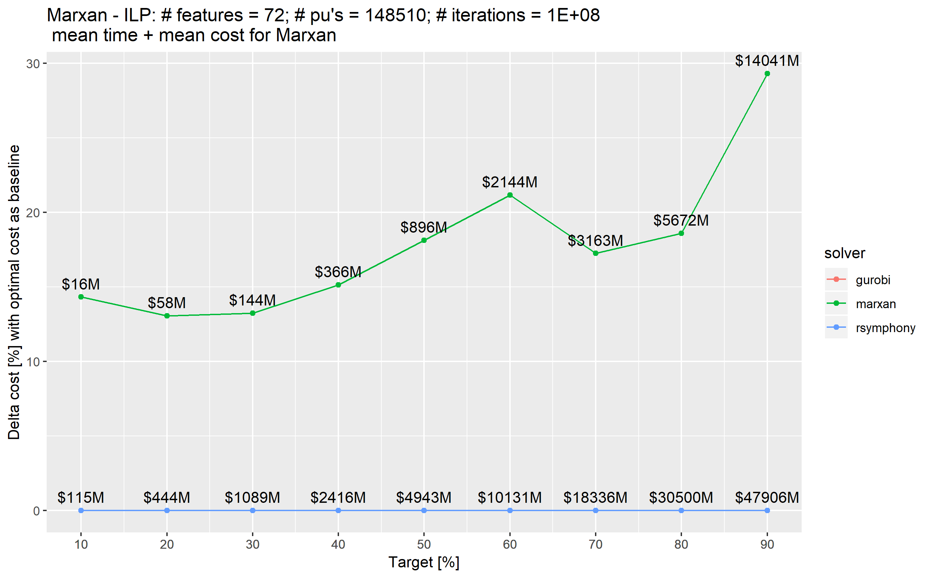
Exact algorithms guarantee optimality

Slide 17
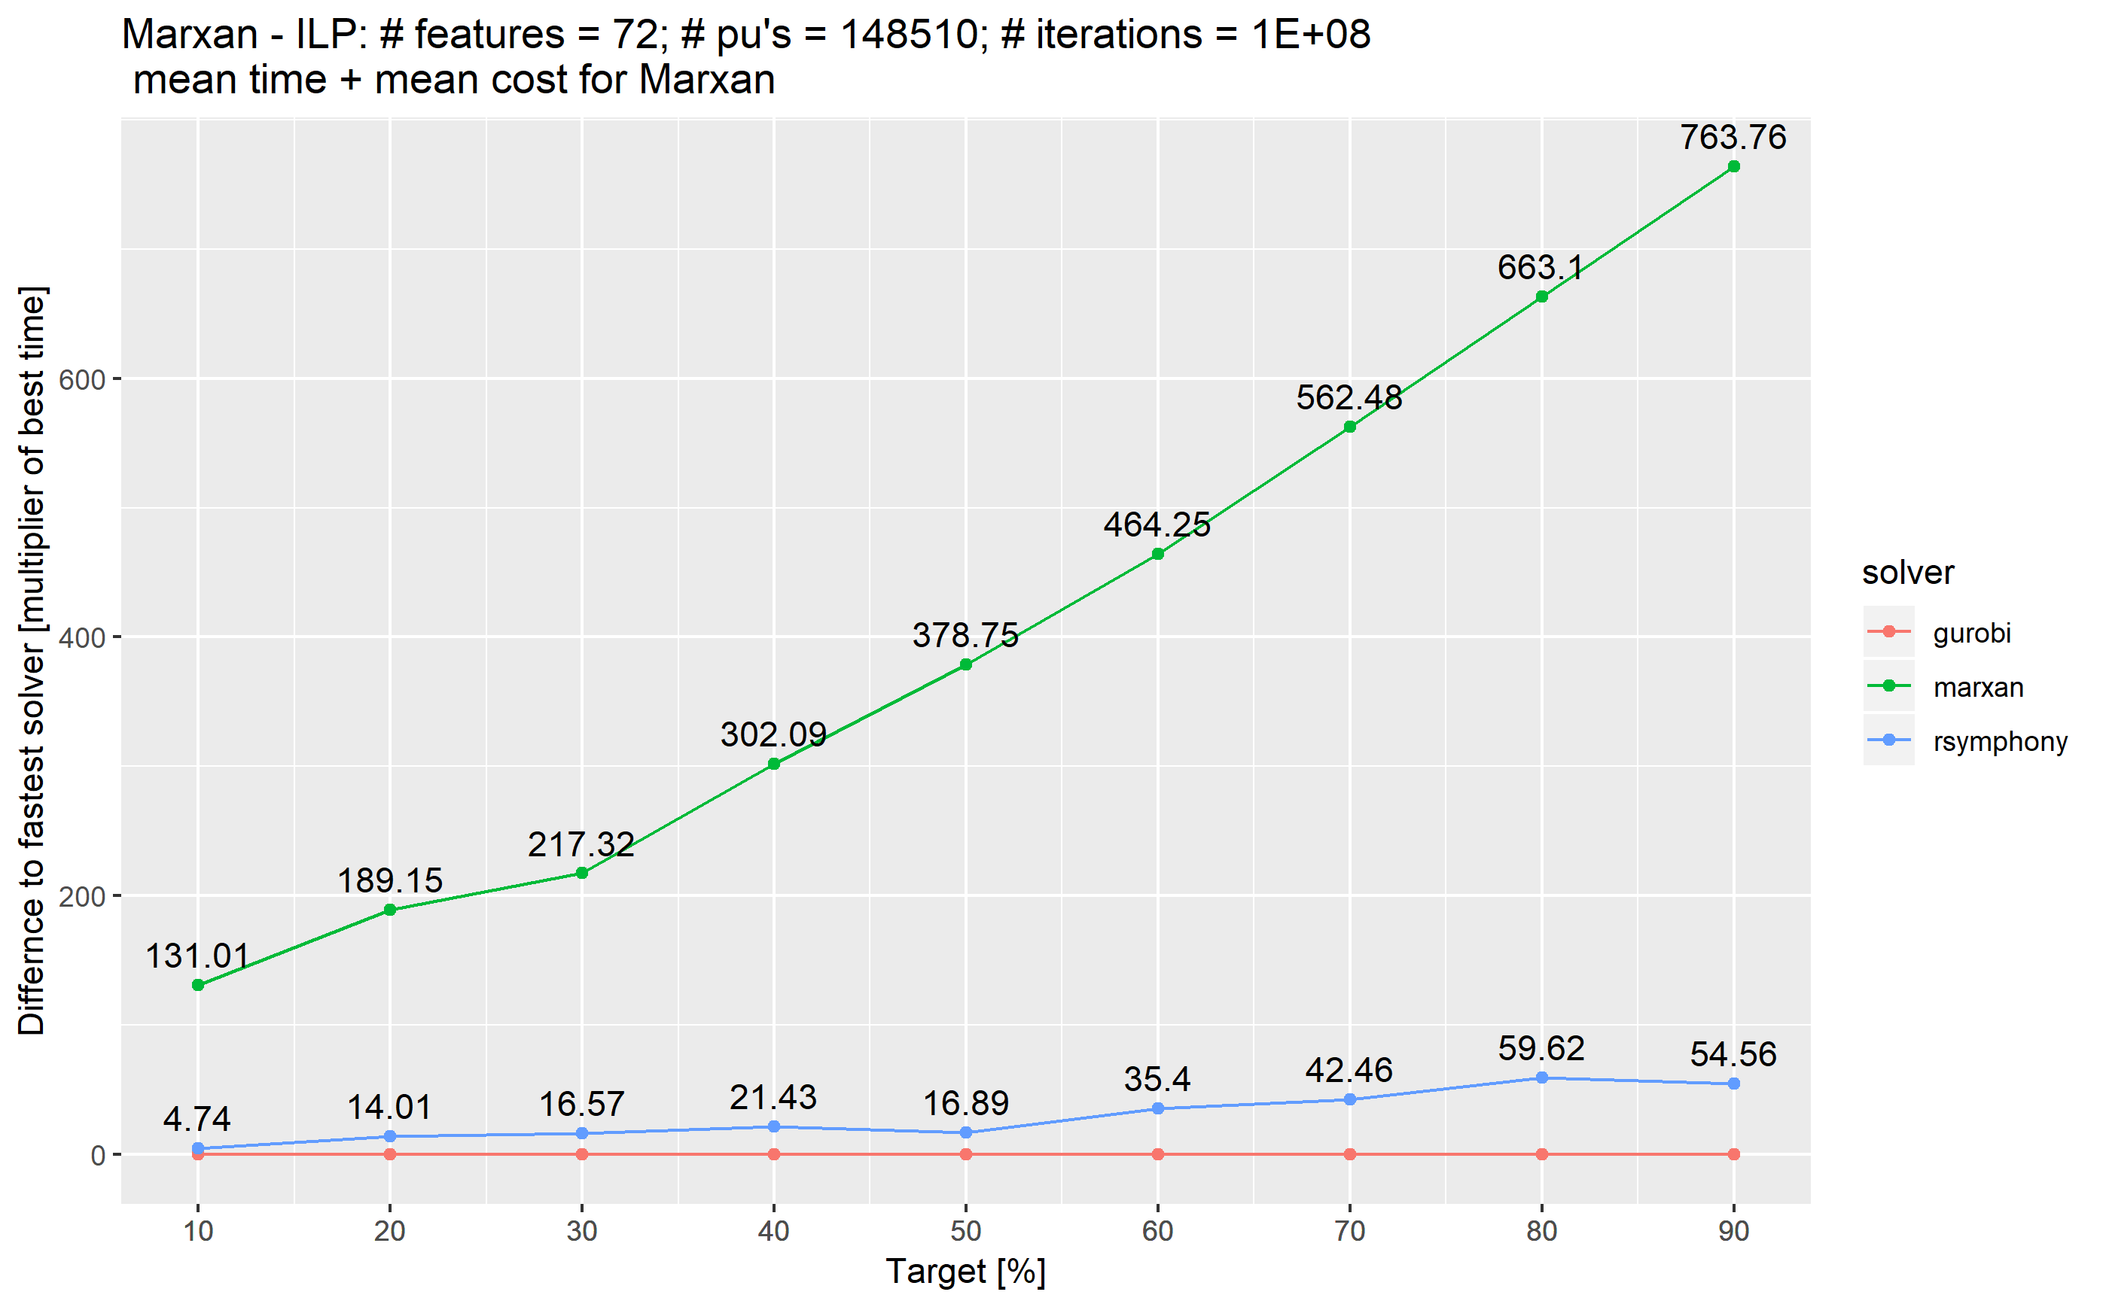
Exact algorithms are fast

Slide 18
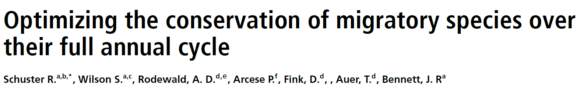
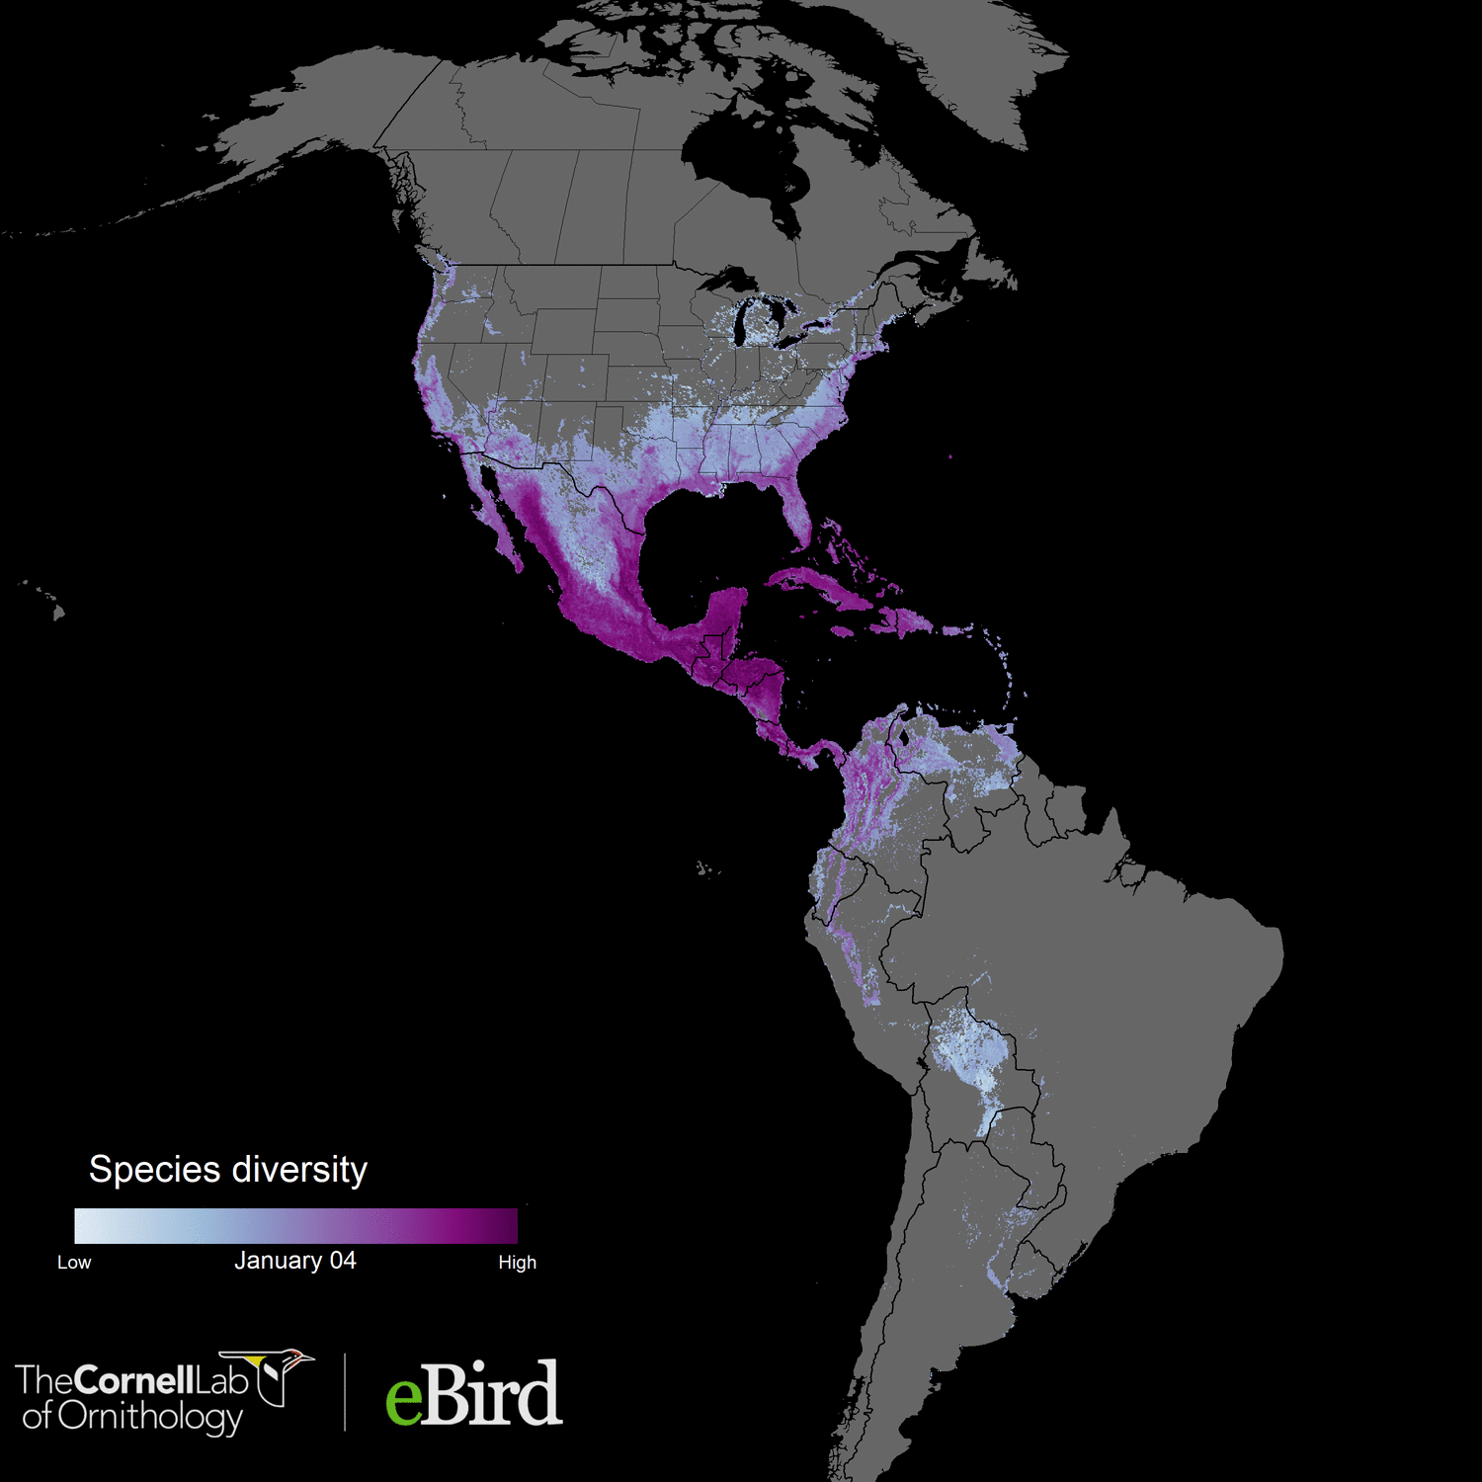

Accepted in Nature Communications
117 species
73 million km²
1.7 million unique locations
14 million checklists
~6000 (52 * 117) weekly abundance maps
1.05 million planning units
Analysis powered by:

Slide 19


The vision
Flexible + powerful framework
+ User friendly (browser) interface
= A novice stakeholder can devise a high-quality, data-driven spatial plan in just one hour.
prioritizr.net

Slide 20

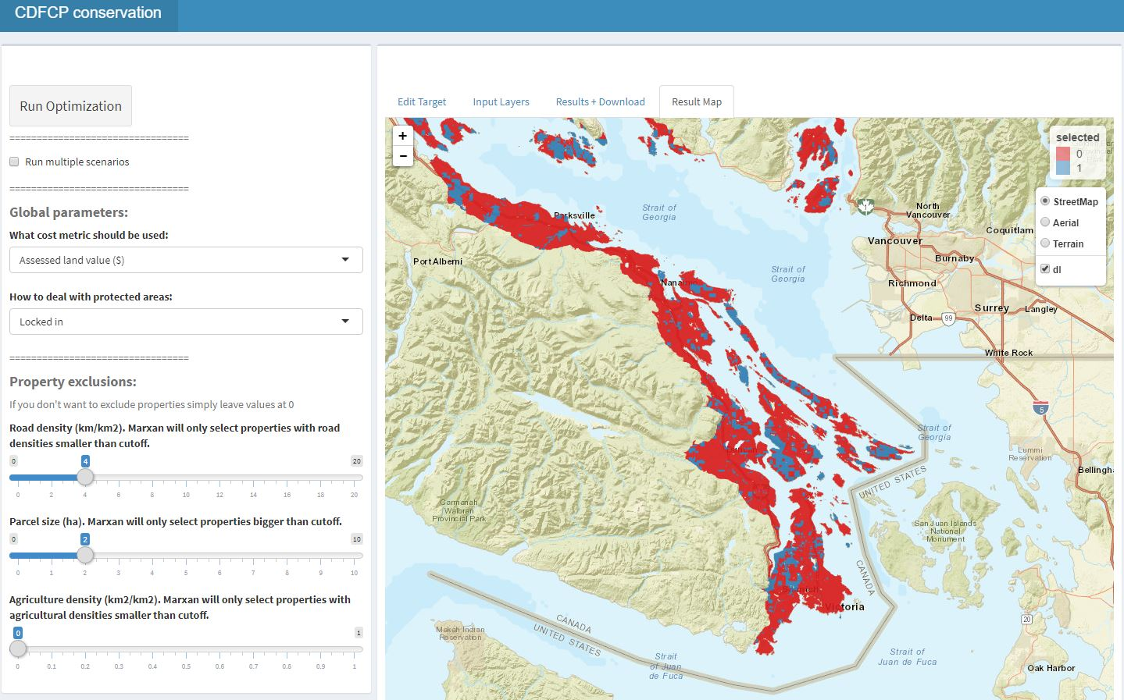

Make it user friendly!

Slide 21










Facilitate Consensus Decisions on Protection

Slide 22
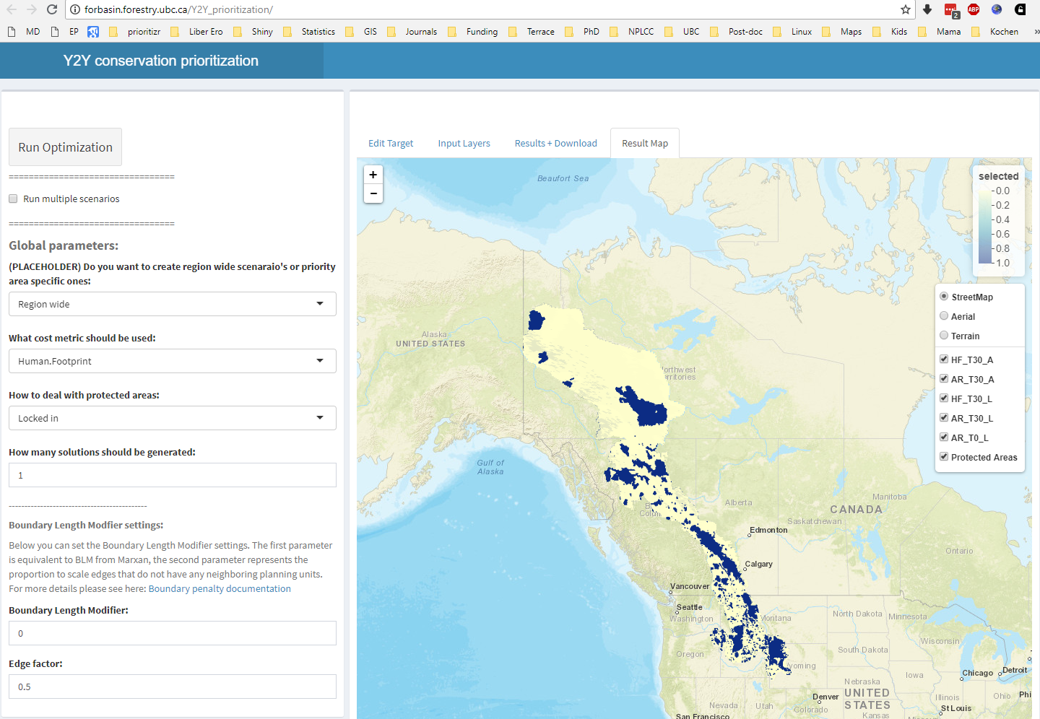
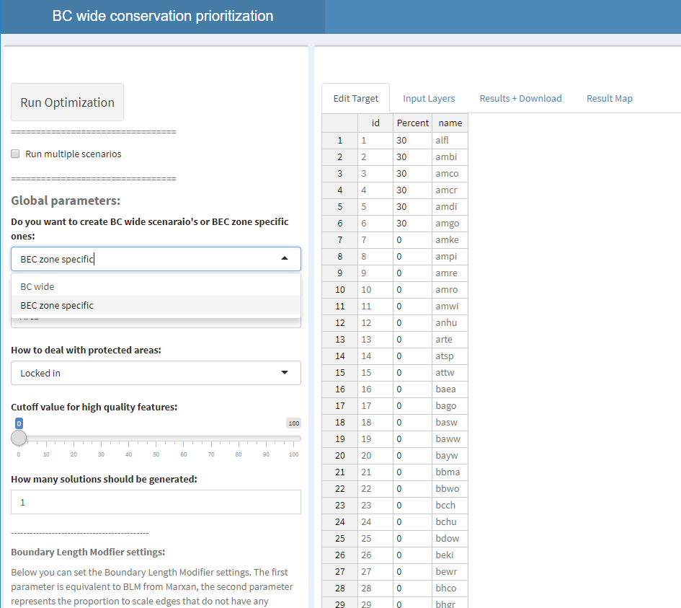

Where has this been used?
CDFCP
Y2Y
Wild Harts
BC wide

Slide 23


Slide 24

Take home message
Flexible + powerful framework
+ User friendly browser interface
= A novice stakeholder can devise a high-quality, data-driven spatial plan in just one hour.
prioritizr.net
jeffrey.hanson@uqconnect.edu.au
richard.schuster@glel.carleton.ca

